Slide 1
Effect of School Funding Inequalities on School Performance and Juvenile Crime
Constanza Schubert
Paulo Sosa
Lisbeth Santana
Notes:
Paulo

Slide 2

Motivation
Inspired by the rise of teacher-led strikes and protests and portrayal of their dire struggle by the media
Detailed investigation into the funding crisis in Florida
Florida per student funding increase is reserved for specific purposes
Only has 47 cents per student to help pay for the regular rising cost of doing school district business
Higher retirement benefits, growing utility costs, employee salary raises or expanded educational offerings
Notes:
Paulo
For instance, teachers across Oklahoma went on strike to protest low pay, overcrowded classrooms, and decreased education spending in April of this year. The strike ended 10 days later after an agreement to increase salaries and funding was reached.
Special purposes: school safety and mental health services

Slide 3
Background
Florida Department of Education (FLDOE) oversees the Florida Education Finance Program (FEFP)
FEFP is supposed to guarantee that each student in the public education system has opportunities to programs and services appropriate to his or her educational needs, which are equal to a similar student
Formula is based on an individual student participating in a particular program and considers several factors, including varying property taxes, program costs, and costs of living
Claims the formula doesn’t discriminate where students live or their economic factors
Definitions
Expenditure: the payment of cash or transfer of property or services for the purpose of acquiring an asset or service. In other words, expenditures are what it costs to run the school district— the “spending” side of the budget.
Revenues: sources of income financing the operation of the school district.
Notes:
Paulo
While this may be true, theoretically, we’ll be examining whether systemic funding inequalities still arise and their impact

Slide 4
Questions/Goals
At a national level:
Does school funding have an effect on juvenile placement rates?
Is there a relationship between school performance and funding?
In the case of Florida school districts:
Is there a significant relationship between school funding attributes and juvenile crime at a county level?
How does school performance (Discipline and Grades) affect total funding?
How does child poverty impact funding?
Notes:
Paulo

Slide 5
Methodology
Explore and gain a deep understanding of the data
Clean datasets, create visualizations, and merge data
Create different predictive models to address questions
Linear Regression
Mixed Effects Linear Model
Regression trees
Hypothesis testing: charter vs non-charter schools performance
Time series analysis: expenditure as share of GDP
Compare results, make improvements, discuss future direction
Notes:
Lisbeth
Visualizations: funding inequality based on geography, tie this to demographics; juvenile crime based on geography
School performance: SAT/ACT scores, state assessments, school grades, improvement ratings

Slide 6
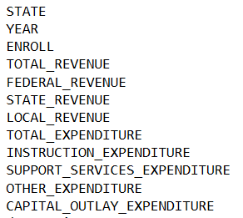
Datasets - School Funding
Obtained from US Census Bureau
Available at a state and district level
Includes federal, state and local revenue
Spending for instruction, support services, among others
Dataset was standardized to funding/expenditure per student enrolled
Notes:
Lisbeth
Preprocesssing

Slide 7
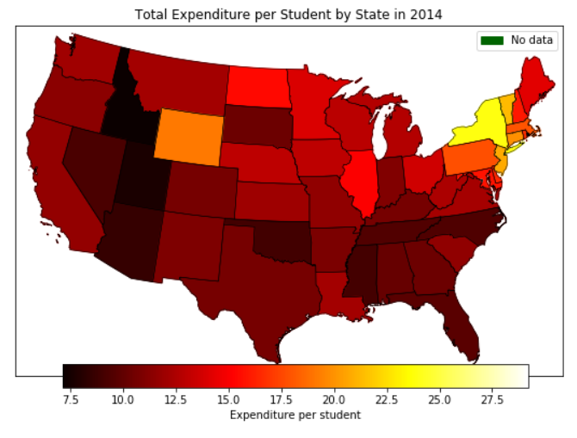
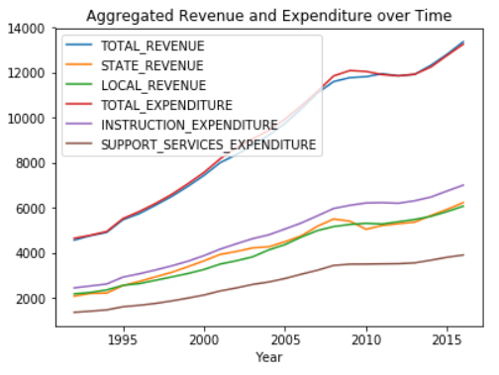
Exploratory Data Analysis - Funding
Notes:
Lisbeth

Slide 8
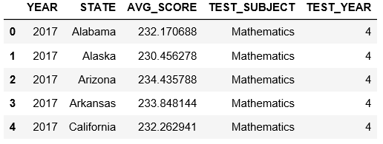
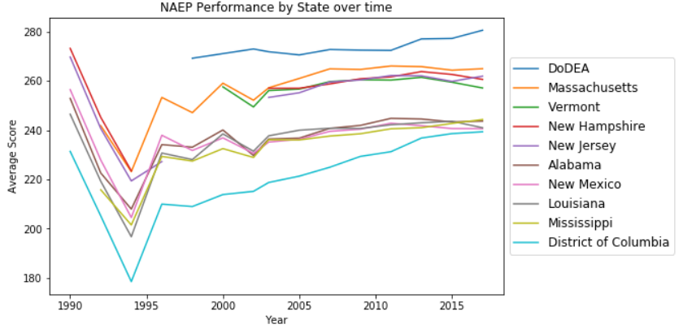
Datasets - NAEP scores
Contains state performance on mathematics and reading tests, for 4th and 8th grade on a selection of years
Notes:
Constanza
-Only used for state comparison analysis
-DoDEA = Department of Defense Education Activity; manages schools for military-connected children

Slide 9
Datasets - Juvenile Placement Rates
From the US Census of Juveniles in Residential Placement (CJRP)
CRJP asks all juvenile residential facilities to report information for each person younger than 21
Rate is the number of juvenile offenders in residential placement per 100,000 juveniles ages 10 through the upper age of original juvenile court jurisdiction in each state
Notes:
Constanza
-to report individual-level information on on gender, date of birth, race, placement authority, most serious offense charged, court adjudication status, and admission date
-younger than 21 assigned a bed in each facility

Slide 10
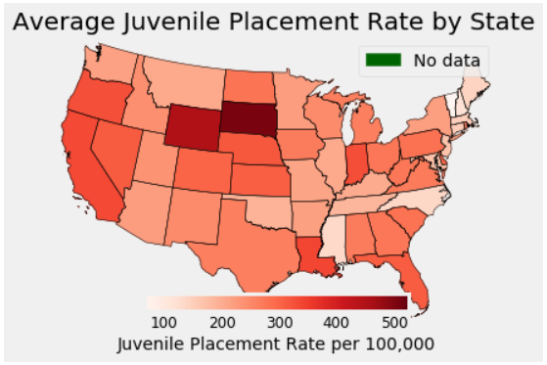
Exploratory Data Analysis - Juvenile Placement
Notes:
Constanza

Slide 11
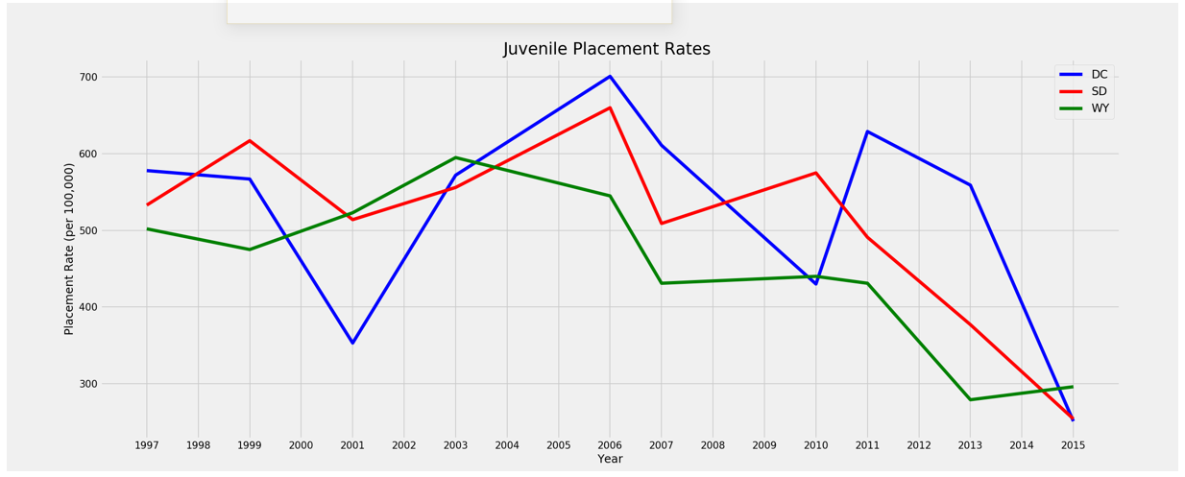
Exploratory Data Analysis - Juvenile Placement
Notes:
Constanza

Slide 12
Datasets - Juvenile Crime Rates
Two data sets were combined
Total juvenile arrests per county
Florida's Uniform Crime Reports
Juvenile population per county
Office of Juvenile Justice and Delinquency Prevention
Notes:
Lisbeth

Slide 13
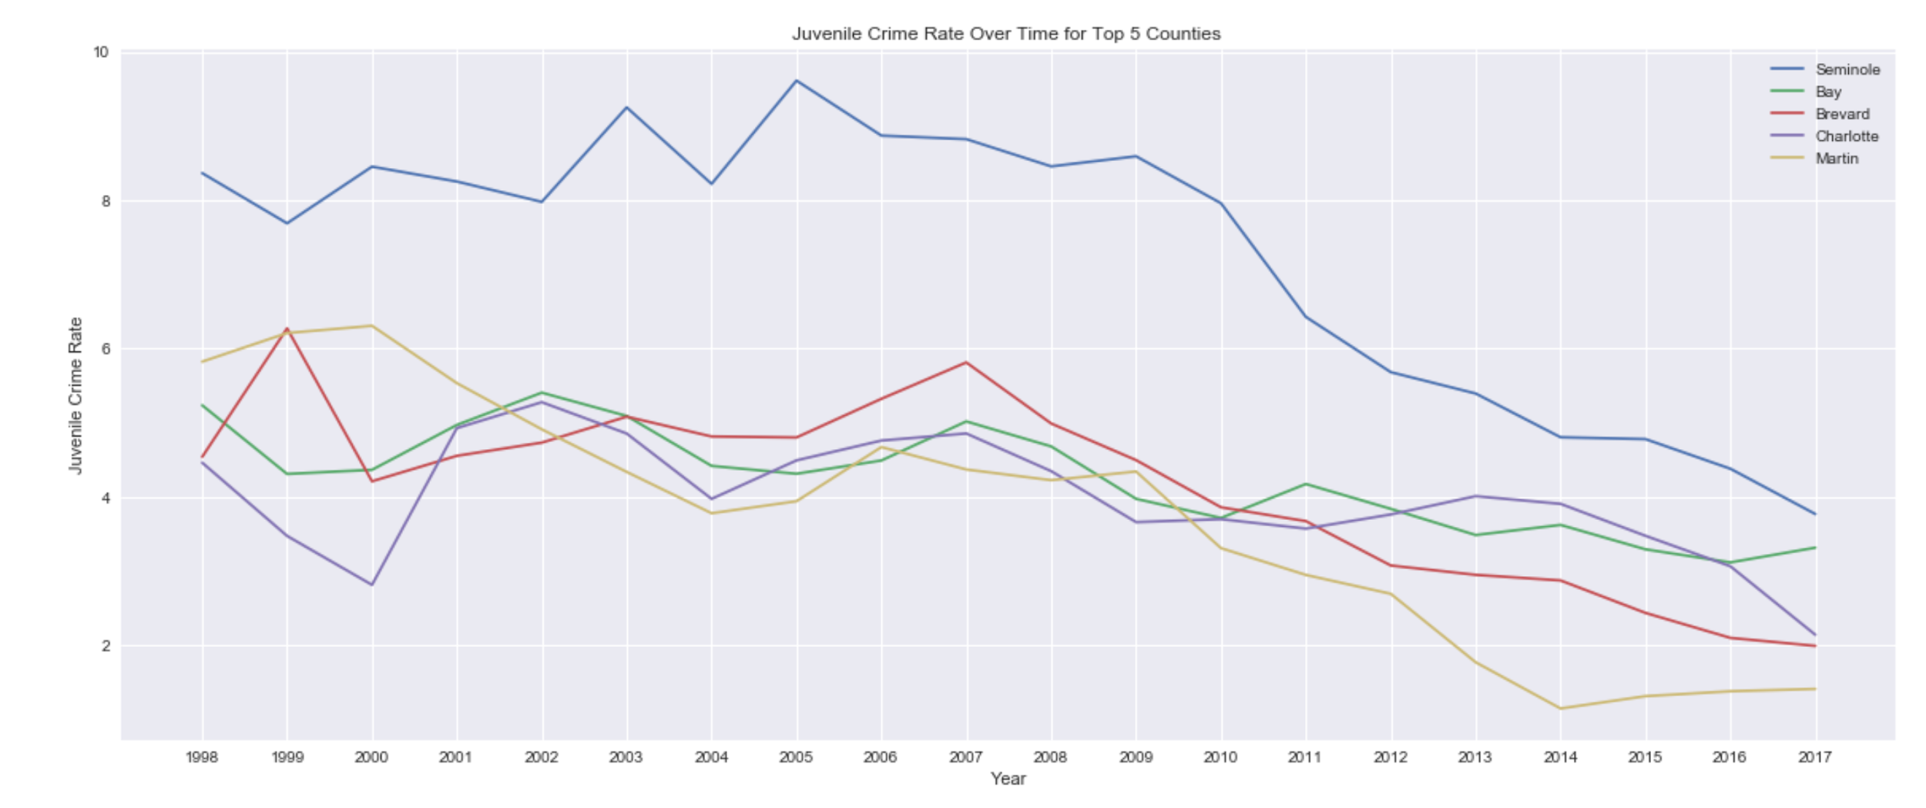
Exploratory Data analysis- Juvenile Crime
Notes:
Lisbeth

Slide 14
Datasets - School District Discipline & Grades
Discipline reports list the number of students by district who have received discipline in the following categories:
Corporal punishment, expulsion, and suspension
School grades is an understandable metric to measure the performance of a school
Incorporates the FSA achievement & learning gains; graduation; and achievement success KPI’s
Notes:
Constanza
Discipline: number of students who received discipline in the following categories:
Corporal punishment Expelled without continuing educational services
Expelled with continuing educational services
Suspension in-school
Suspension out of school

Slide 15
Datasets - Child Poverty Rates
Obtained from U.S. Census Bureau’s Small Area Income and Poverty Estimates (SAIPE)
SAIPE includes annual estimates poverty statistics for school districts
Number of children ages 5 to 17
Number of related children ages 5 to 17 in families in poverty
Rate = # children 5-17/ # children in families in poverty
Notes:
Constanza
In addition, in order to implement provisions under Title I of the Elementary and Secondary Education Act as amended, we produce the following estimates for school districts:
total population
number of children ages 5 to 17
number of related children ages 5 to 17 in families in poverty

Slide 16
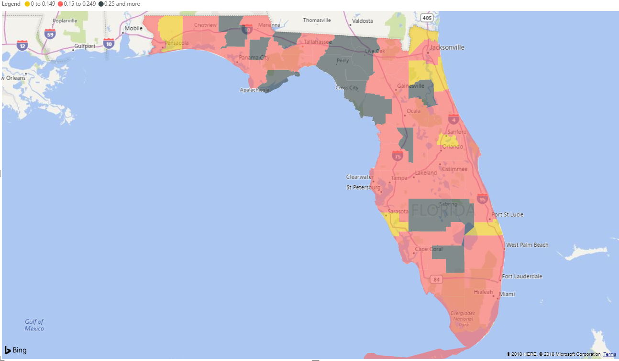
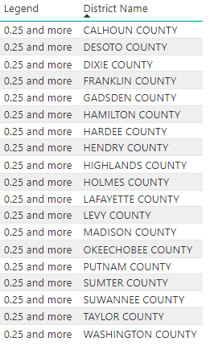
Exploratory Data Analysis - Child Poverty Rates
Notes:
Constanza
Putnam
Desoto
Hamilton
Hardee
Dixie

Slide 17
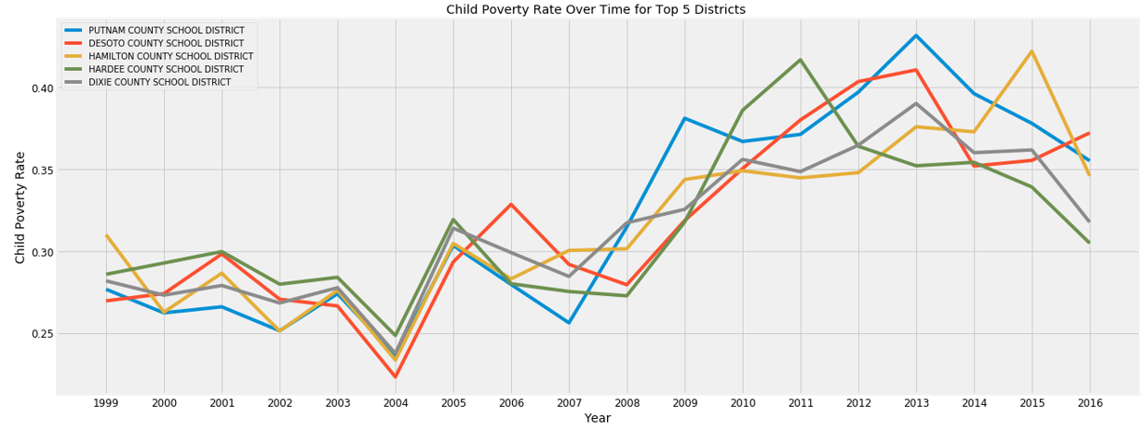
Exploratory Data Analysis - Child Poverty Rates
Notes:
Constanza
Putnam
Desoto
Hamilton
Hardee
Dixie

Slide 18
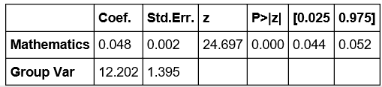
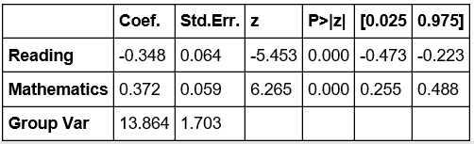
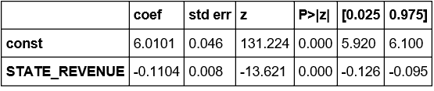
National Analysis: Revenues
Math score as input; total revenue as response
Extended to include reading score
Mixed Effect Linear Models
Compared to OLS models
State revenue as input; placement rate as response RLM: used log(y) transformation
RMSE: 4.04
RMSE: 0.45
RMSE: 4.16
Notes:
Constanza
A series of scatter plots were created vs placement rate to choose independent variables
Coefficients were smaller for OLS

Slide 19
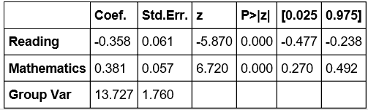
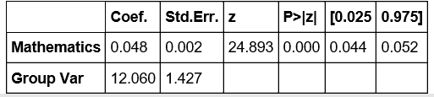
National Analysis: Expenditures
Mixed Effect Linear Models
Compared to OLS models
No meaningful result for placement rate as response variable
Math score as input; total expenditure as response
Extended to include reading score
RMSE: 3.99
RMSE: 4.10
Notes:
Constanza
A series of scatter plots were created vs placement rate to choose independent variables
Mixed models are a form of regression model, meaning that the goal is to relate one dependent variable (also known as the outcome or response) to one or more independent variables (known as predictors, covariates, or regressors). Mixed models are typically used when there may be statistical dependencies among the observations. More basic regression procedures like least squares regression and generalized linear models (GLM) take the observations to be independent of each other. Although it is sometimes possible to use OLS or GLM with dependent data, usually an alternative approach that explicitly accounts for any statistical dependencies in the data is a better choice

Slide 20
Florida School Districts: Funding vs. Juvenile Crime
Least Squares Linear Regression and Linear Mixed Models
Relevant features for Least Squares
Local Revenue (+)
Total spending on support services (-)
Total spending on instruction (-)
Time (+)
These features explain about 80% of the variation in Juvenile crime rates
RMSE: 1.29
Mixed Linear Model placed importance on “Other Current Spending” instead of “Total Spending on Support Services”
RMSE: 1.32
Notes:
Lisbeth

Slide 21
Florida School Districts: Performance vs. Funding
Least Squares Regression model
Target: Total Revenue
Relevant features:
Grades (-)
A = 1
F = 5
Time (+)
98.6 % of variability in Total Revenue can be explained by Grades and Year
RMSE: 1.56
Mixed Linear Models showed similar findings with RMSE of 1.61
Notes:
Lisbeth

Slide 22
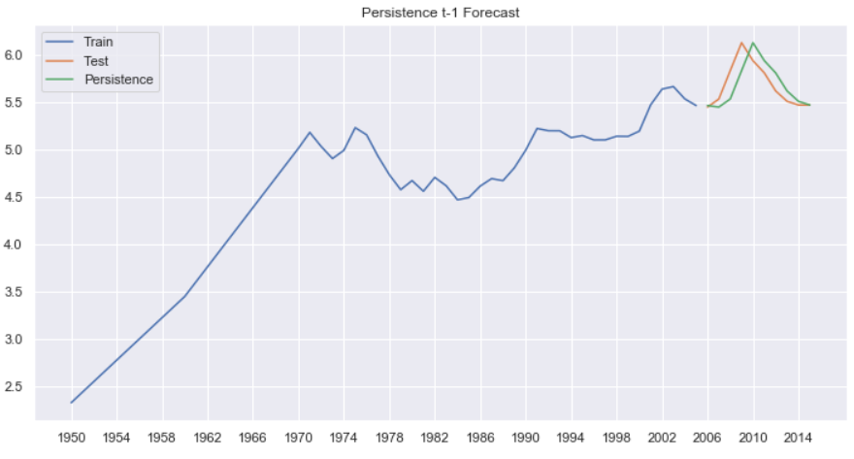
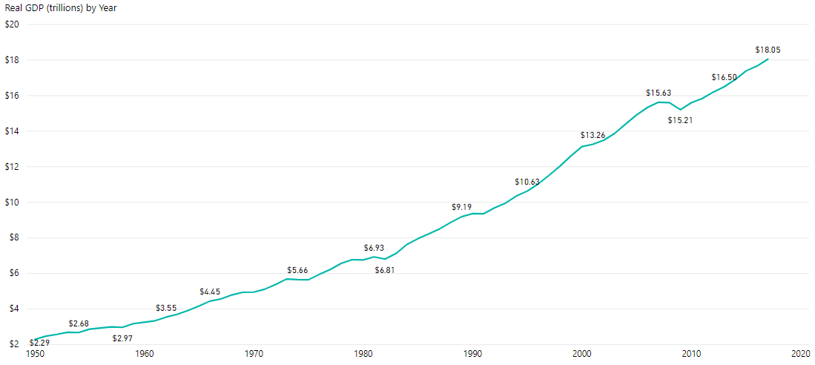
Time Series Analysis
Expenditure as % of GDP for United States
Persistence
Historical mean & median
Expanding window
Rolling window
Moving Average
Notes:
Paulo
Persistence Forecast
Historical mean and median
Expanding Window Forecast- adding from previous
Rolling Window Forecast
Moving average or medium
Lowest MSE was persistence with t-1 (using previous year to predict next year)
GDP is going up while the Education expenditure is going down

Slide 23
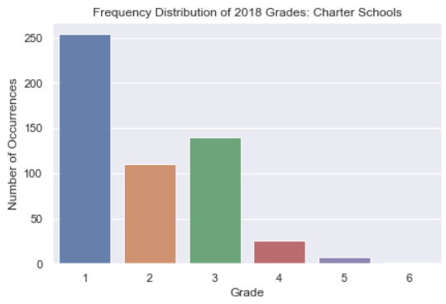
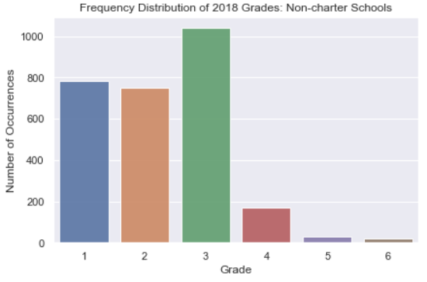

Hypothesis Testing
Is there a significant difference in the grade performance of charter schools and non-charter public schools?
A non-parametric test must be used for ordinal data
Mann-Whitney U test
Notes:
Paulo
Since the school grades data is ordinal, we need to use a non-parametric hypothesis test to compare the two independent samples (non-charter and charter). The Mann-Whitney U test is a nonparametric statistical significance test for determining whether two independent samples were drawn from a population with the same distribution.
Reject the null hypothesis. There is a significant difference in the grade performance of charter schools compared to non-charter public schools.

Slide 24

Challenges
Data collection
Clean datasets
Noisy data
Small sample sizes
Notes:
Paulo
Data collection- finding data that we can use
Cleaning data sets-
Preparing data
Small sample sizes- finding data that was to small to make sense of

Slide 25
Improvements
Obtain demographics for school districts
Different metric for state level performance
Additional performance metrics for school districts
Notes:
Lisbeth

Slide 26
Conclusions
There is an inverse relationship between state revenues and juvenile placement rates
Higher math scores seem to be related to increasing expenditures
Higher grades seem to be related to more school funds
Local Revenue seems to be related to an increase in juvenile crime rates
There is a significant difference in grade performance between charter schools and non-charter public schools
Notes:
Paulo

